Slide 1


INSTITUTE: CHANDIGARH UNIVERSITY
DEPARTMENT: UIC
MCA
SOFTWARE TESTING
24CAH-654
DISCOVER . LEARN . EMPOWER

Slide 2
SOFTWARE TESTING
Unit -3
Test Management using JIRA

Slide 3
Work Flows
In Jira Software, the path your issues take from creation to completion is called workflow. Each workflow is composed of a set of statuses and transitions that your issue moves through during its lifecycle and typically represents work processes within your organization.
A Jira workflow represents the process your team uses to take an issue from creation to completion. The illustration below is an example workflow:

Slide 4
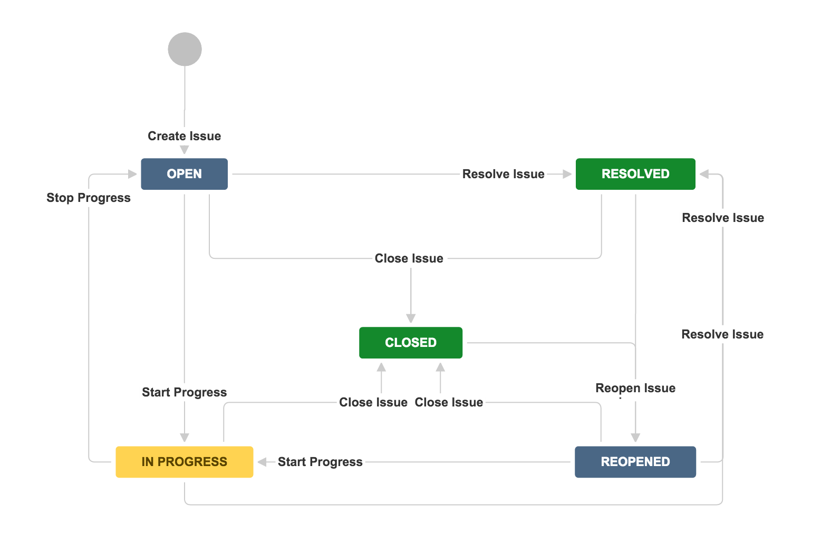

Slide 5
Jira workflows are composed of 3 unique elements:
Status: A status indicates where the issue is within the workflow. Some examples may include: Open, In Progress, In Review, Scheduled, Pending, Waiting, etc.
Transition: A transition represents the action being taken to move an issue from status to status. A transition is a one-way link, so if an issue needs to move back and forth between two statuses, two transitions need to be created.
Resolution: When a task is completed and no longer open, it needs a resolution status. Some examples may include: Closed, Resolved, Shipped, Completed, Done, Finalized, Won’t Do, etc. (This is only available in company-managed projects).

Slide 6
Here are some key points about workflows:
Components:
Workflows consist of a set of steps or stages, each representing a specific task or activity. These steps are often interconnected by transitions or dependencies.
Roles and Responsibilities:
Workflows often involve multiple participants, each with specific roles and responsibilities. Clear delineation of roles helps ensure that tasks are performed by the right individuals.
Iterations:
Workflows can be iterative, with feedback loops that allow for revisions and improvements based on previous outcomes or experiences.

Slide 7
Plug-ins in JIRA
JIRA, developed by Atlassian, supports a wide range of plugins (now referred to as apps) that extend its functionality and features. These apps can be used to customize JIRA based on specific business needs, integrate with other tools, and enhance overall productivity. Here are some common types of apps (formerly known as plugins) used in JIRA:
Automation Apps:
Apps like JIRA Automation allow users to automate repetitive tasks and processes within JIRA. They provide rule-based triggers and actions that can be set up to streamline workflows.

Slide 8
2. Reporting and Dashboards:
Apps such as eazyBI and Better Excel for Jira enable advanced reporting and dashboard customization. These apps go beyond the built-in JIRA reporting capabilities, providing more extensive analytics and visualization options.
3. Integration Apps:
JIRA integrates with various third-party tools and platforms. Integration apps, like the ones for Slack, GitHub, Confluence, or Bitbucket, help connect JIRA with other tools to ensure seamless collaboration and communication.
4. Agile and Scrum Tools:
Agile and Scrum methodologies are widely used in JIRA. Apps like Tempo Timesheets, Advanced Roadmaps (formerly Portfolio for Jira), and BigPicture enhance JIRA's capabilities for agile project management.

Slide 9
5. Security and Permissions:
Security and permissions can be extended using apps like SAML Single Sign-On for Jira and Resolution SSO. These apps help manage user authentication, authorization, and access control.
6. Custom Fields and Forms:
Apps like ProForma and Power Custom Fields help in creating custom fields and forms. This allows users to capture specific information tailored to their business needs.
7. Time Tracking Apps:
Time tracking apps such as Tempo Timesheets and Clockwork Automated Timesheets help teams track and manage their work hours directly within JIRA.
8. Workflow Diagrams:
Apps like Draw.io Diagrams for Confluence and Lucidchart Diagrams for Jira enable users to create and embed workflow diagrams directly within JIRA or Confluence.

Slide 10
THANK YOU

